Slide 1
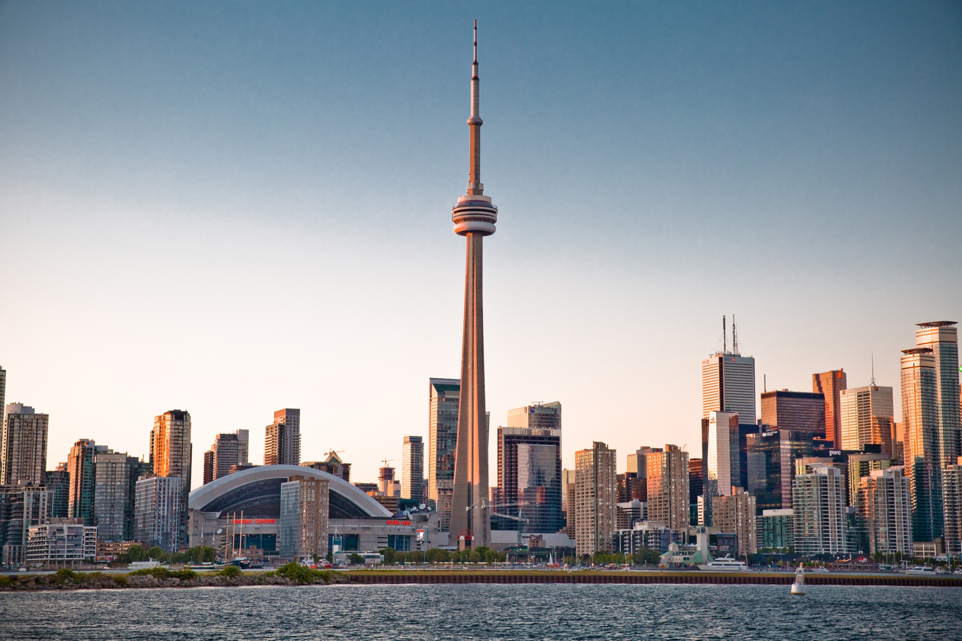
Battle f Neighbourhoods
Ajey Rajkumar

Slide 2

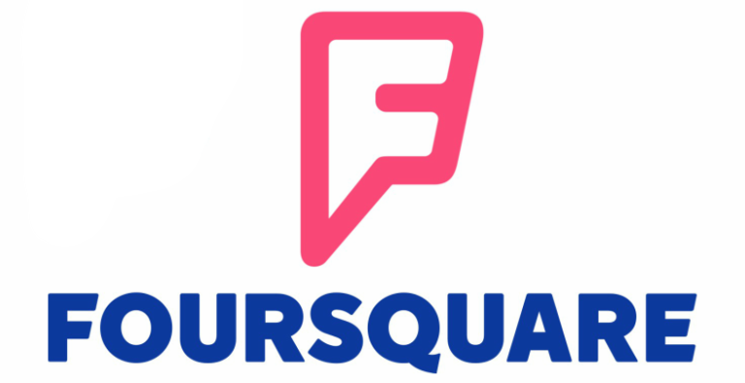
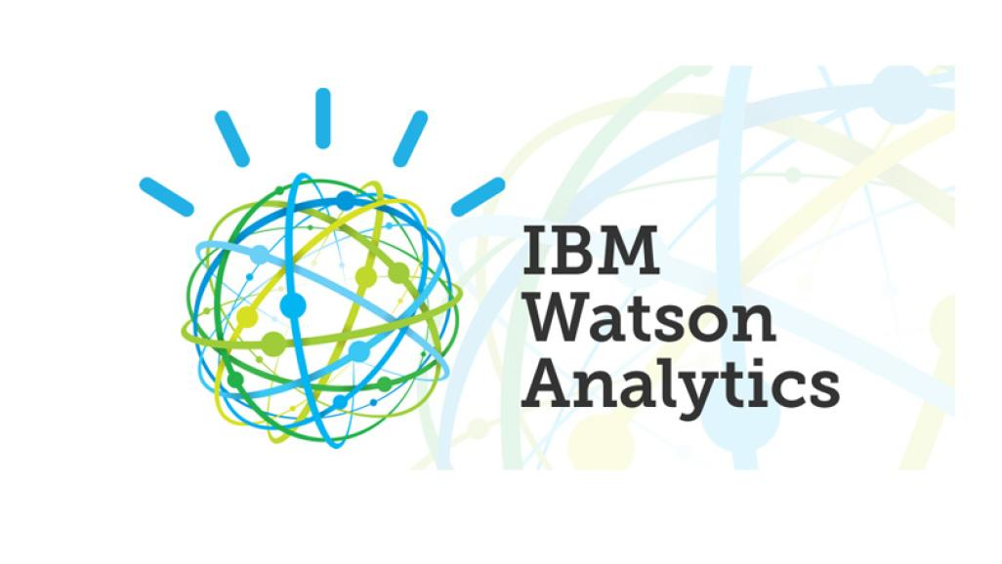

Introduction
This is an IBM Applied data science project performed using

Slide 3
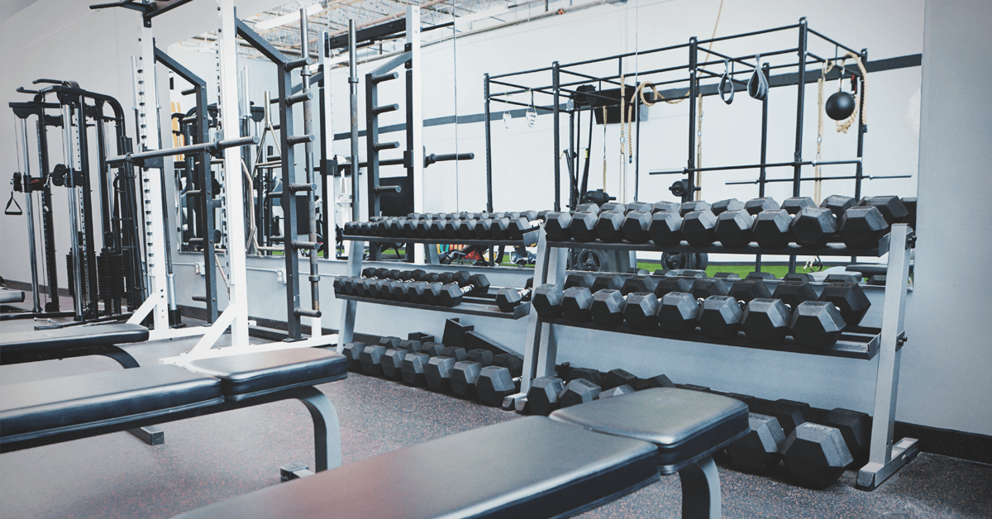
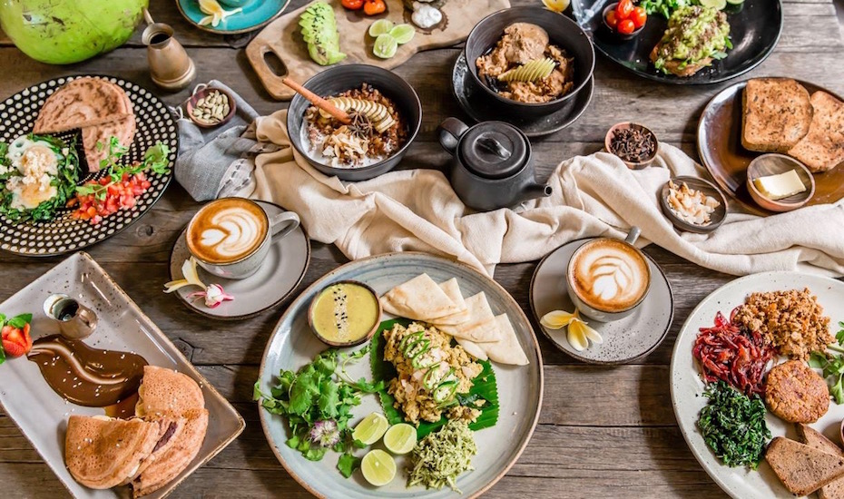
Business Problem
To identify neighbourhoods and cluster neighbourhood groups based on the needs of man moving to Toronto for a prolonged stay.
Needs:
Gym
Vegan Restaurants

Slide 4
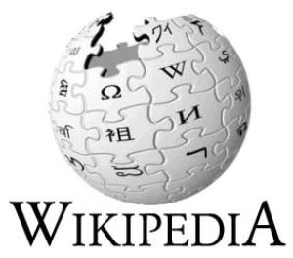
Data
The data required for clustering of neighbourhoods were web scraped from Wikipedia and Foursquare.

Slide 5
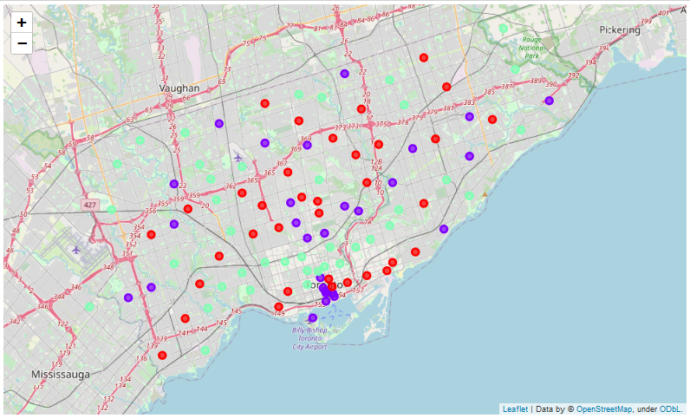
Results
For the scenario 1 the neighbourhoods have been divided into three different clusters based on the gyms available in each neighbourhoods,
Cluster 0 – This cluster neighborhoods has the moderate number of Gyms
Cluster 1 – The neighborhoods in this clusters have a high number of Gyms
Cluster 2 – This neighborhoods barely has any Gyms

Slide 6
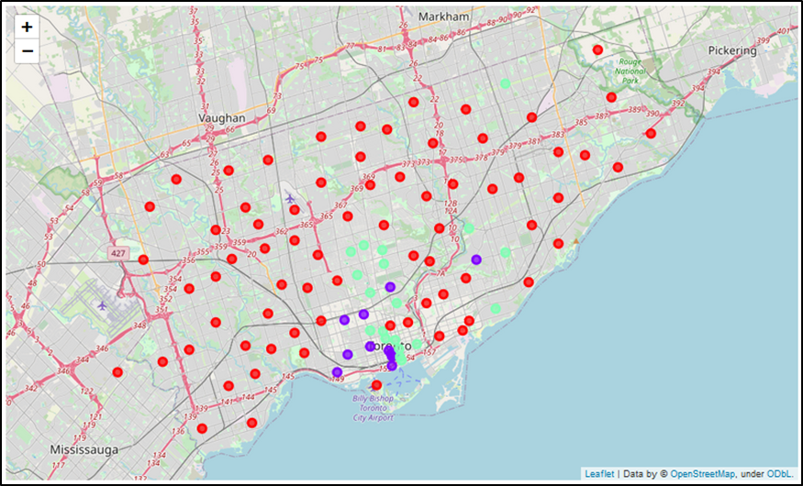
Results
For the scenario 2 the neighbourhoods have been divided into three different clusters based on the Vegans / Vegetarians Restaurants available in each neighbourhoods,
Cluster 0 – This cluster neighbourhoods have no Vegan / Vegetarian restaurants
Cluster 1 – The neighbourhoods in this clusters have a high number of Vegan / Vegetarian restaurants
Cluster 2 – The neighbourhoods in this cluster have a moderate number of Vegan / Vegetarian restaurants

Slide 7
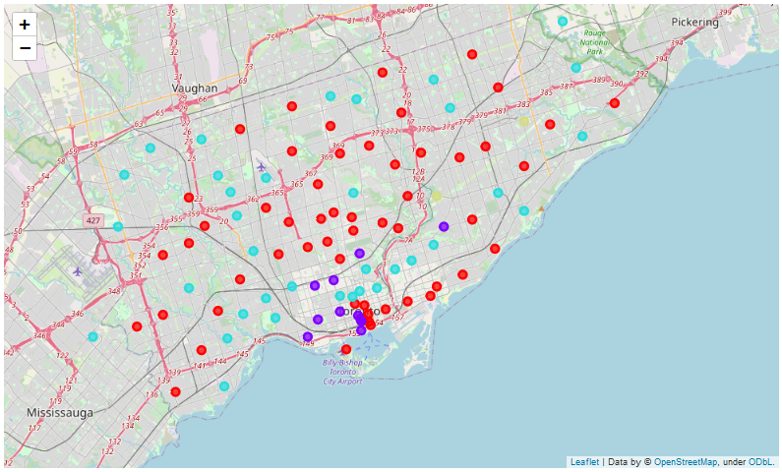
Results
For the scenario 3 the neighbourhoods have been divided into four different clusters based on the number of Gyms and Vegans / Vegetarians Restaurants available in each neighbourhoods,
Cluster 0 – This cluster neighbourhoods have moderate number of Vegan / Vegetarian restaurants and Gyms
Cluster 1 – The neighbourhoods in this clusters have a high number of Vegan / Vegetarian restaurants and a moderate number of Gyms.
Cluster 2 – The neighbourhoods in this clusters have Vegan / Vegetarian restaurants but no gyms
Cluster 3 – The neighbourhoods in this cluster have the highest number of gyms but have a low number of Vegan / Vegetarian restaurants

